Slide 1
Data Manipulation

Slide 2
EDA vs. Data Mining

Slide 3
Exploratory Data Analysis (EDA) is an approach of analyzing data sets to summarize their main characteristics.
Exploratory Data Analysis

Slide 4
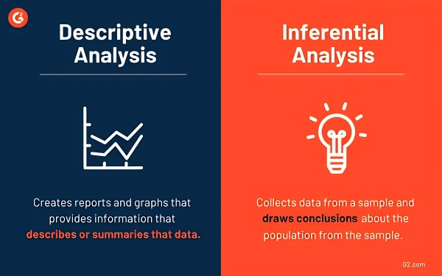
Exploratory Data Analysis
Descriptive Analysis

Slide 5
Exploratory Data Analysis
Descriptive Analysis
Organizing and summarizing data using numbers & graphs
Data Summary: Bar Graphs, Histograms, Pie Charts, Shape of graph & skewness
Measures of Central Tendency: Mean, Median & Mode
Measures of Variability: Range, Variance & Standard deviation

Slide 6
Data mining is the process of extracting and discovering patterns in large data sets involving methods at the intersection of machine learning, statistics, and database systems.
Data Mining

Slide 7
Data Mining
Inferential Analysis

Slide 8
Data Mining
Inferential Analysis
Using sample data to make an inference or draw a conslusion of the population
Uses probability to determine how confident we can be that the cnoclusions we make are correct. (Confidence Intervals & Margin of Error)

Slide 9
Storytelling

Slide 10
The benefits of data storytelling
Adding value to your data and insights.
Interpreting complex information and highlighting essential key points for the audience.
Providing a human touch to your data.
Offering value to your audience and industry.
Building credibility as an industry and topic thought leader.

Slide 11
Making sure your data story is valuable
Think about your theory. What do you want to prove or disprove? What do you think the data will tell you?
Collect data. Collate the data you’ll need to develop your story.
Define the purpose of your story. Using the data you gathered, you should be able to write what the goal of your story is in a single sentence.
Think about what you want to say. Outline everything from the intro to the conclusion.
Ask questions. Were you right or wrong in your hypothesis? How do these answers shape the narrative of your data story?
Create a goal for your audience. What actions would you like them to take after reading your story?

Slide 12
Using data visualization to enhance your data storytelling
Reveal patterns, trends, and findings from an unbiased viewpoint.
Provide context, interpret results, and articulate insights.
Streamline data so your audience can process information.
Improve audience engagement.

Slide 13

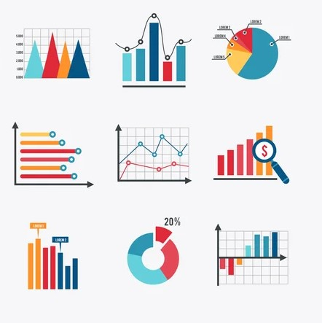

The three key elements of data storytelling
Build your narrative
Use visuals to enlighten
Show data to support

Slide 14
Data sources
Kaggle
Public Institutions (GUS, NYC Open Data, data.gov, etc.)
Wikidata
Web Scraping
Google Dataset Search

Slide 15
Reference
https://towardsdatascience.com/an-extensive-guide-to-exploratory-data-analysis-ddd99a03199e
http://guidetodatamining.com/
https://www.researchgate.net/profile/Dr-Subhendu-Pani/publication/337146539_IJITEE/links/5dc70b124585151435fb427e/IJITEE.pdf
https://www.microsoft.com/en-sg/power-platform/products/power-bi/topics/data-storytelling
https://www.redalyc.org/pdf/2990/299023509014.pdf
https://en.wikipedia.org/wiki/Exploratory_data_analysis
https://en.wikipedia.org/wiki/Data_mining
https://www.youtube.com/watch?app=desktop&v=VHYOuWu9jQI&ab_channel=TheOrganicChemistryTutor

